Slide 1
Sistem & Arsitektur Komputer
IF-5010
Kuliah#2

Slide 2
The Memory System
1. Components of the Memory System
2. The Memory Hierarchy
3. Cache Memories
4. Cache Organization
5. Replacement Algorithms
6. Write Strategies
7. Virtual Memory

Slide 3
Components of the
Memory System
• Main memory: fast, random access,
expensive,located close (but not inside) the
CPU. It is used to store program and data
which are currently manipulated by the
CPU.
• Secondary memory: slow, cheap, direct
access, located remotely from the CPU.

Slide 4
Problems with the Memory System
What do we need?
We need memory to fit very large programs and to work at a speed comparable to that of the microprocessors.
Main problem:
- microprocessors are working at a very
high rate and they need large
memories;
memories are much slower than
microprocessors;
Facts:
- the larger a memory, the slower it is;
the faster the memory, the greater the
cost/bit.

Slide 5
A Solution
It is possible to build a composite memory system which combines a small, fast memory and a large slow main memory and which behaves (most of the time) like a large fast memory.
The two level principle above can be extended into a hierarchy of many levels including the secondary memory (disk store).
The effectiveness of such a memory hierarchy is based on property of programs called the principle of locality (see slide 10).

Slide 6
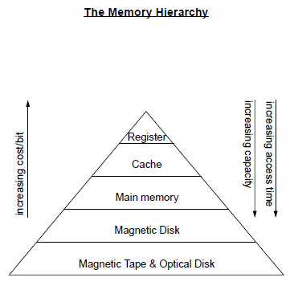

Slide 7
The Memory Hierarchy (cont’d)
Some typical characteristics:
1. Processor registers:
  - 32 registers of 32 bits each = 128 bytes
  - access time = few nanoseconds
2. On-chip cache memory:
  - capacity = 8 to 32 Kbytes
  - access time = ~10 nanoseconds
3. Off-chip cache memory:
  - capacity = few hundred Kbytes
  - access time = tens of nanoseconds
4. Main memory:
  - capacity = tens of Mbytes
  - access time = ~100 nanoseconds
5. Hard disk:
  - capacity = few Gbytes
  - access time = tens of milliseconds

Slide 8
The Memory Hierarchy (cont’d)
The key to the success of a memory hierarchy is if data and instructions can be distributed across the memory so that most of the time they are available, when needed, on the top levels of the hierarchy.
• The data which is held in the registers is under the direct control of the compiler or of the assembler programmer.
• The contents of the other levels of the hierarchy are managed automatically:
  - migration of data/instructions to and from caches is performed under hardware control;
  migration between main memory and backup store is controlled by the operating system (with hardware support).

Slide 9
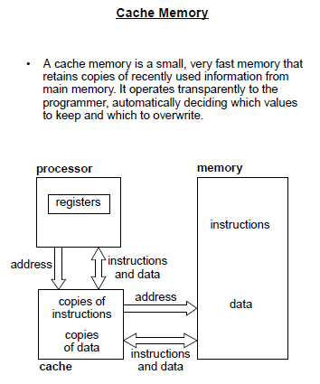

Slide 10
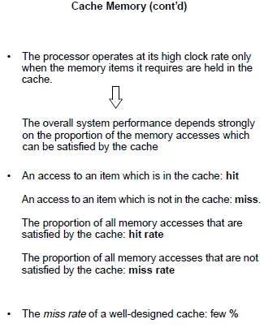

Slide 11
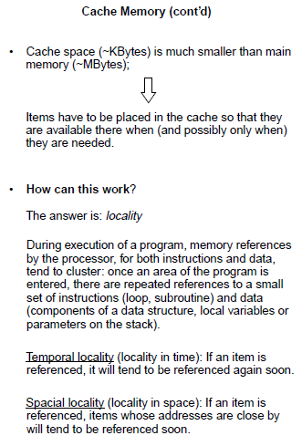

Slide 12
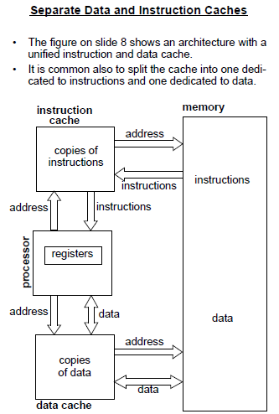

Slide 13
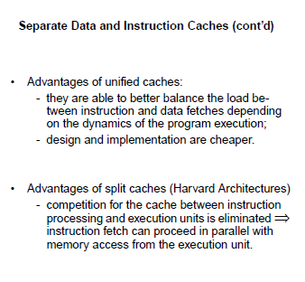

Slide 14
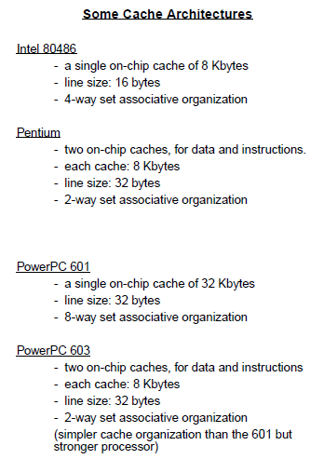

Slide 15
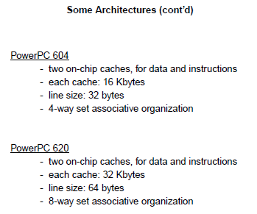

Slide 16
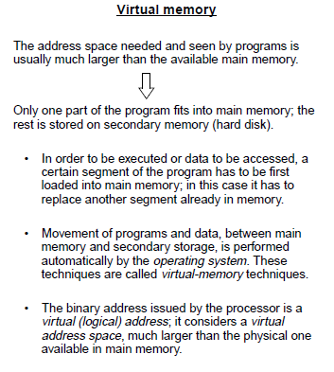

Slide 17
